Slide 1
Adding AND/OR Graph Support to CSQ Algorithm

Slide 2
Symbolic Plan Recognition
The process of inferring another agent’s plans, based on observations of its interaction with its environment.
In general, plan recognition relies on a plan library of plans potentially executed by the observed agent.
The recognizer matches observations to specific plan steps in the library using an FDT.

Slide 3
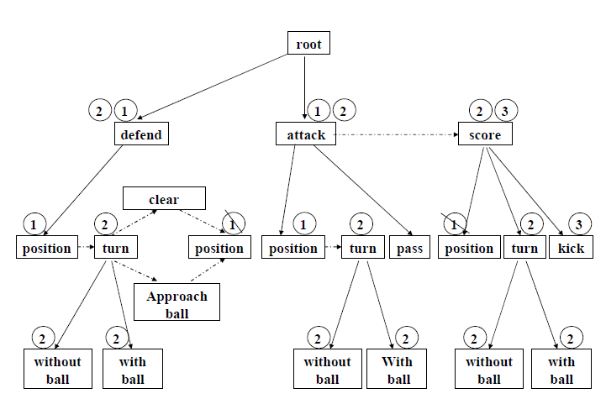

Slide 4
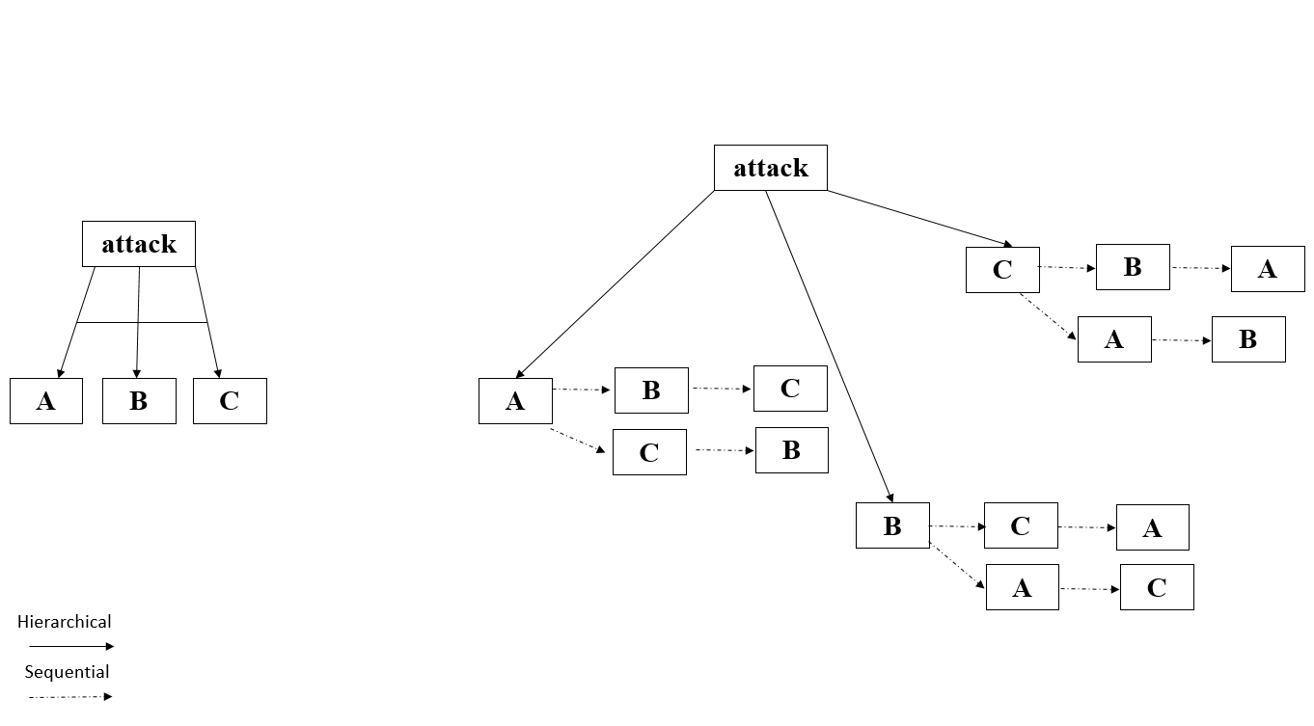
AND/OR Plan Library Representation

Slide 5
Plan Library: Definitions and Notation
AND/OR graph G, is defined as follows:
G = <V_{O}, V_{A}, E_{H}, E_{S­­}, R>
V_{O} = OR vertices, V_{A} = AND vertices
E_{H} = Hierarchical edges, E_{S} = Decomposition edges­­
R = Root vertex, R ∈ V_{O} ∩V_{A}
V_{O} ∩V_{A} = ∅, E_{H} ∩E_{S} = ∅
We define the following operators:
∀ v ⊆ V_{O} ∪ V_{A}:
Parent(v) = {u | (u, v) is a hierarchical edge}
Note that Parent(v) is a singleton function.
∀ v ⊆ V_{O}:
Prev(v) = {w | (w, v) is a sequential edge}
∀ v ⊆ V_{A}:
Prev(v) is implicitly defined – can be each of its siblings or nothing.
Sibling(v) = {w | {u, w} is a hierarchical edge and u ∈ Parent(v)}

Slide 6
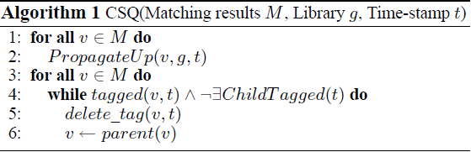
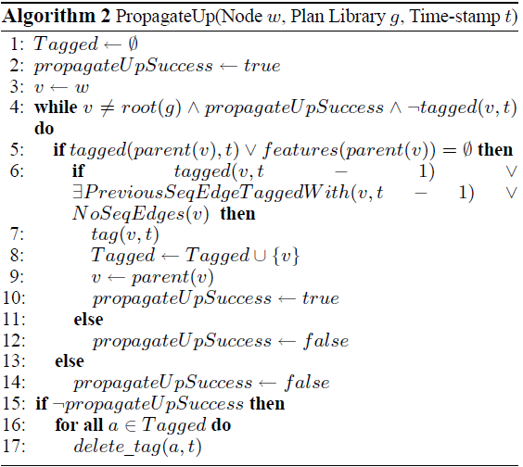
CSQ Algorithm

Slide 7
CSQ Algorithm Modification
Algorithm 1 PropagateUp(Node w, Plan Library g, Time-stamp t)
1: Tagged ← ∅
2: propagateUpSuccess ← true
3: v ← w
4: while v ≠ root(g) ∧ propagateUpSuccess ∧ ¬tagged(v, t) do
5: if tagged(Parent(v), t) V features(parent(v)) = ∅ then
6: if (Parent(v) ∈ V_{O} ∧ (tagged(v, t - 1) V
ExistsPreviousSeqEdgeTaggedWith (v, t - 1) V
NoSeqEdges(v))) V Parent(v) ∈ V_{A} then
7: tag (v, t)
8: Tagged ← Tagged ∪ {v}
9: v ← parent(v)
10: propagateUpSuccess ← true
11: else
12: propagateUpSuccess ← false
13: else
14: propagateUpSuccess ← false
15: if ¬propagateUpSuccess then
16: for all a ∈ Tagged do
17: delete_tag (a, t)

Slide 8
Algorithms Equivalence
Claim 1. Parent(v) ∈ V_{A} => tagged (v, t - 1) V ExistsPreviousSeqEdgeTaggedWith (v, t -1) V NoSeqEdges(v) ≡True
Proof: Parent(v) ∈ V_{A}, by definition of Prev(v) for v ∈ V_{A}, there is always a case in which NoSeqEdges(v) is true. Therefore, we can assume: Parent(v) ∈ V_{A} => NoSeqEdges(v) ≡True. Under this assumption it holds that: Parent(v) ∈ V_{A} => tagged (v, t - 1) V ExistsPreviousSeqEdgeTaggedWith (v, t -1) V NoSeqEdges(v) ≡tagged (v, t - 1) V ExistsPreviousSeqEdgeTaggedWith (v, t -1) V True ≡ True.

Slide 9
Results Meaning
If there is a first child for each possible observation and the parent is tagged with time stamp t, or has no observable features – CSQ will except every possible observation.
the CSQ algorithm can be tricked by an agent that changes plans rapidly.
This might result in predictions that have no actual value.

